Slide 1

Modeling Basics
Modeling Basics
The start-to-finish of Bayesian Cognitive Modeling
Saee Paliwal
TNU CPC
August, 2016

Slide 2
The 5 W’s of Modeling
who
All cognitive agents model (insects, animals, humans)
what
Learning from data to understand and make predictions about one’s surroundings.
where
Everywhere, even where there’s no data (i.e. sensory deprivation chambers)!
when
All day, every day.
why
The ability to understand and predict our environments ensures our survival.
how
Frequentists vs Bayesian

Slide 3
Hamish’s Scottish Taverne Menu
Frequentist approach
Haggis
Haggis deluxe
Haggis supreme
Haggis a la mode
Haggis au gratin
Chicken Tikka Masala
Haggis flambée
Haggis surprise
Make-your-own Haggis
Something else involving Haggis
Allows us to characterize the likelihood of an event given the data alone (i.e. how frequently does an event occur)
Likelihood ratio, non-Haggis to Haggis:
1:10

Slide 4
The Bayesian approach
Bayes Theorem:
Prior: P(X=x)
Likelihood: P(data|X=x)
Posterior: P(X=x|data)
Posterior Likelihood * Prior
Full equality:
Posterior = Likelihood * Prior = P(data|X=x)P(X=x)
Model Evidence Σ_{x’}P(data|X=x’) P(X=x’)
Bayes rule allows us to infer causes by examining effects, and to incorporate beliefs into our models of the world.

Slide 5
The prior
What information do we have before we see any data?
Prior odds ratio 75: 15

Slide 6
Applying Bayes Theorem
Prior odds ratio 75: 15
Likelihood ratio 1: 10
Posterior odds ratio 75: 150 → 1:2
So there’s a 50% chance that you think you’re not eating sheep stomach. Success.

Slide 7
Observing the observer
How do we want to apply this framework?
From a subject’s data, we want to

Slide 8

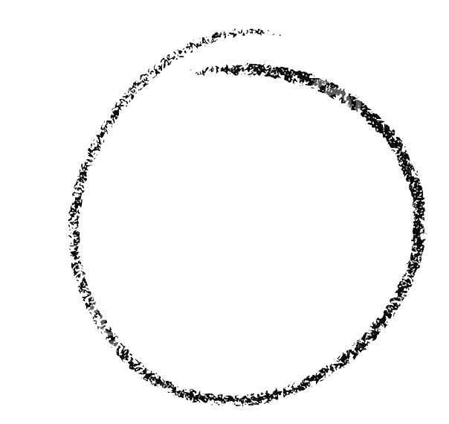

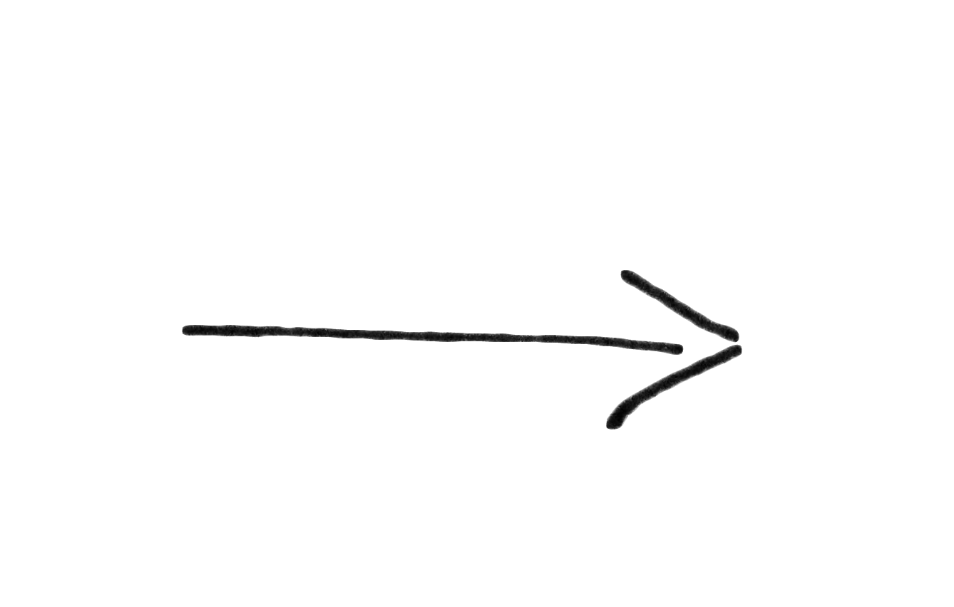
Prep Time:
Longer than you think
Cook Time:
1 PhD duration, or until funding runs out
Plating/serving:
Serve with journal of your choice
Recipe:
Bayesian Cognitive Model
Ingredients:
1 Question or Interest Area
1 well-formed Hypothesis
1 medium-sized Task
1 ripe Model Class
9”x12” Inversion Technique
1 heaping Tbsp Simulations
2 cups Data
Model selection

Slide 9

Step 1: Question
How do we learn about our physical world? More specifically, how do we learn about the structural integrity of a system?
Step 2: Hypothesis
We gauge the structural integrity of a physical system using the following variables:
Mass
Height
Positioning

Slide 10
Step 3: Task
Which of these will fall? In which direction will they fall?

Slide 12

Step 4: Model

Slide 13
Step 4: Our proposed Model

Slide 14
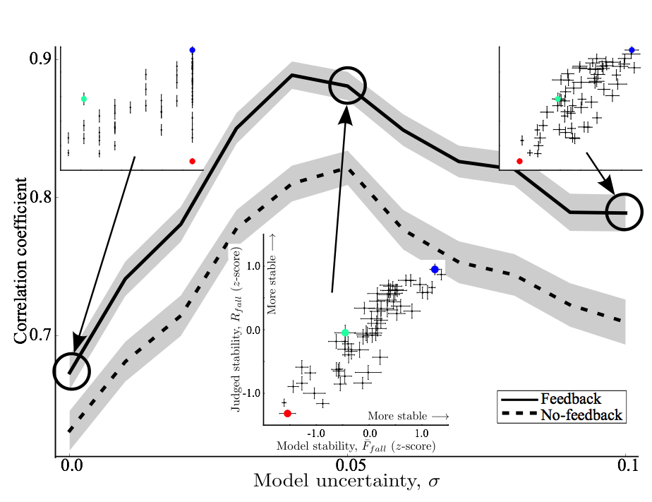
Step 5: Simulations
Notes:
Why and how do we do simulations. Create a LARGE set of data, why do you do this, can you recover the parameters, are they correlated. How small a set of data can you get to still get a reasonable result. Can you separate the model families. Fminsearch, gradient descent, then sampling and VB

Slide 15
Step 6: Model Inversion
Different types of model inversion: Sampling versus Variational
Sampling: Mechanism, Advantages, Drawbacks
Variational methods: Mechanism, Advantages, Drawbacks
Elaborated on: Day 2-3

Slide 16
Step 8: Model Parameters
Construct validity with external measures.
Elaborated on: Day 2-3

Slide 17
Step 9: Cook and plate
Model comparison using free energy.
What is free energy?
Lower bound on model evidence.
Accuracy complexity tradeoff.
Select optimal model.
Elaborated on: Day 2-3

Slide 18
Finally: Serve and clean!
Send to journal
Achieve world-wide celebrity
Clean up and start with a new dish!
Elaborated on: Day 2-3

Slide 19
Thank you!

Slide 20
Questions?

Slide 21

Special sauce: Bayes

